Slide 1
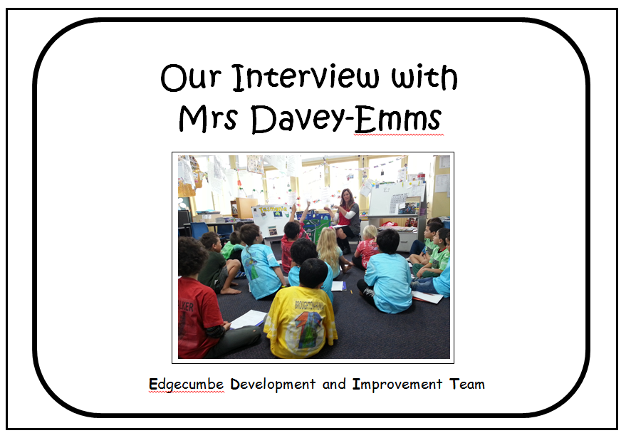
Our Interview with
Mrs Davey-Emms
Week 5, Term 3 2013

